Slide 1
Global Population, GDP & Social Indicators Analysis
Power BI
ARUNKUMAR A DA & DS

Slide 2
Project Overview
Analyzed global population and economic data
Compared regions and countries
Focused on GDP, literacy, infant mortality, and growth trends
Built interactive Power BI dashboards

Slide 3
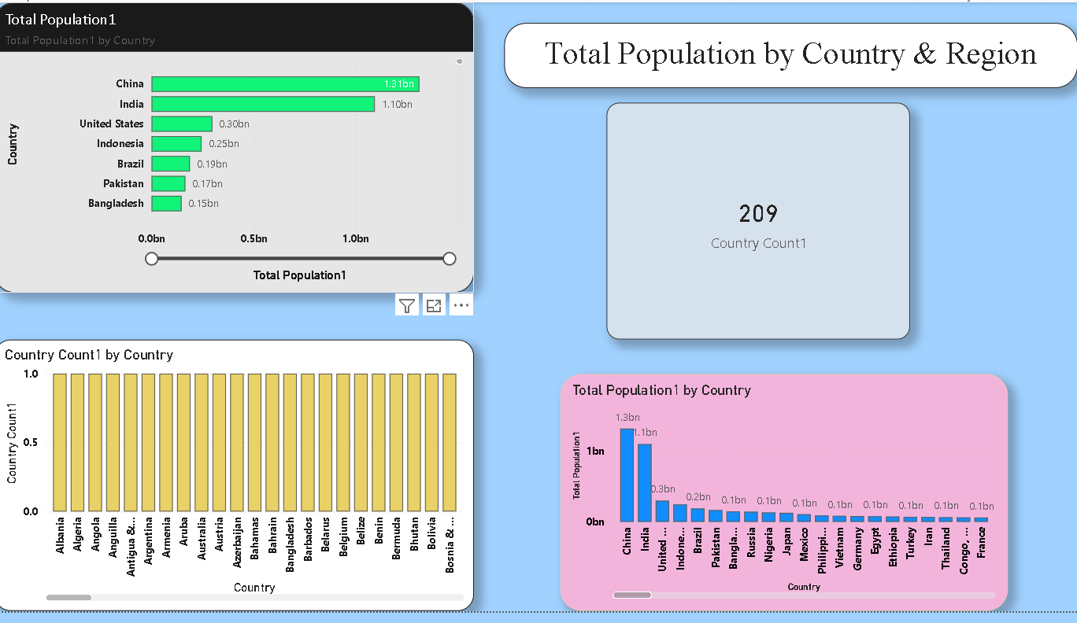
Population Analysis
Asia has the highest population
Oceania and Baltics have the lowest population
Population distribution is uneven across regions

Slide 4
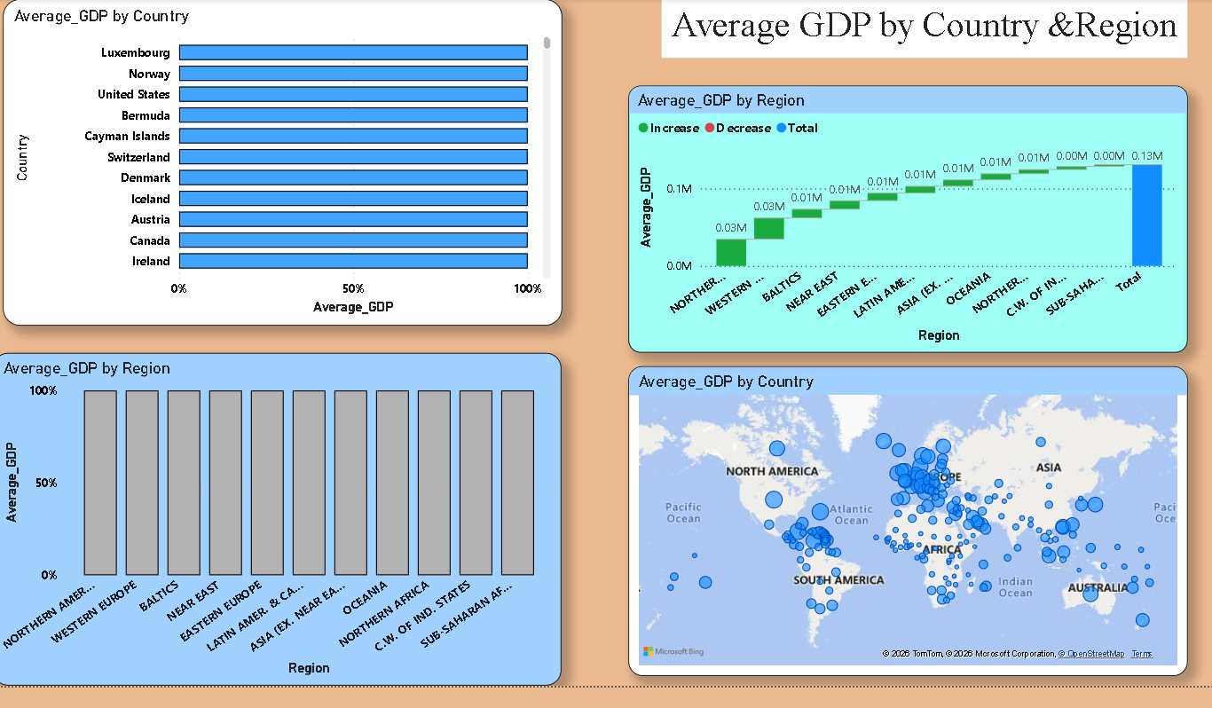
GDP Analysis
Western Europe and Northern America have highest average GDP
Sub-Saharan Africa has the lowest average GDP
GDP does not directly depend on population size

Slide 5
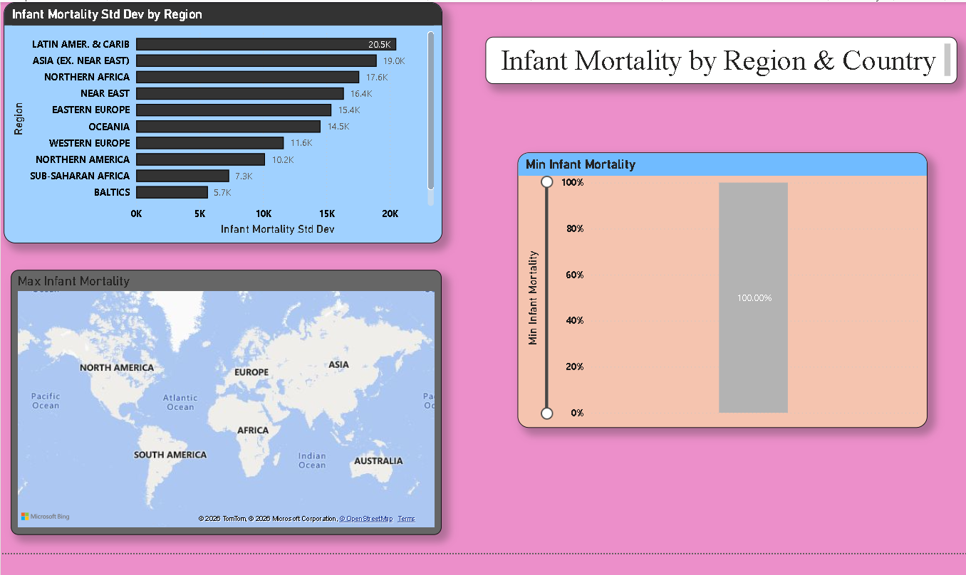
Infant Mortality Analysis
High infant mortality in low-income countries
Developed countries show very low infant mortality
Healthcare quality strongly impacts mortality rates

Slide 6
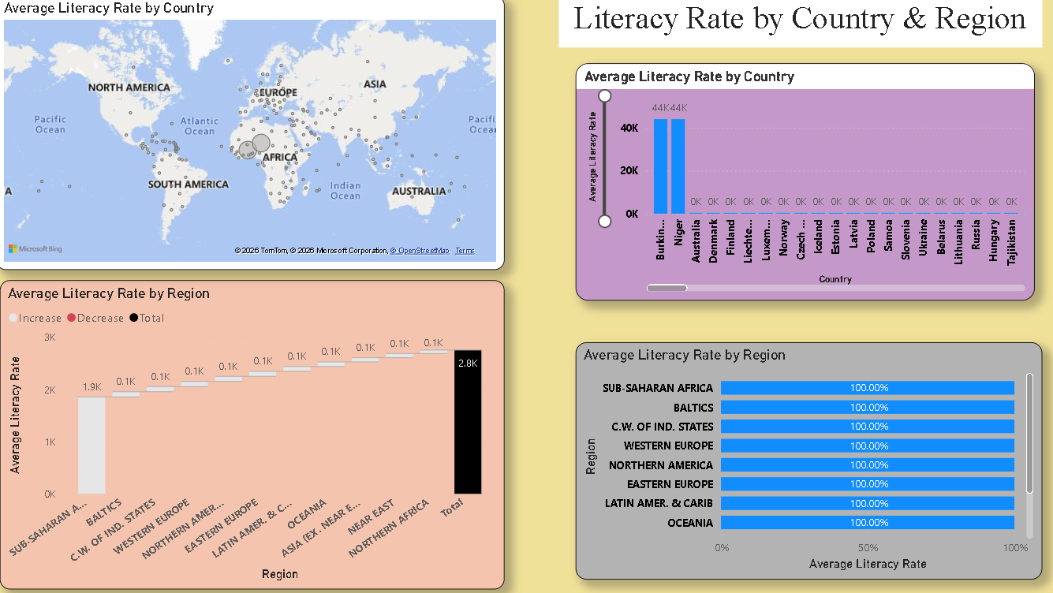
Literacy Rate Analysis
Europe shows near 100% literacy
Sub-Saharan Africa has the lowest literacy rate
Higher literacy supports better economic performance

Slide 7
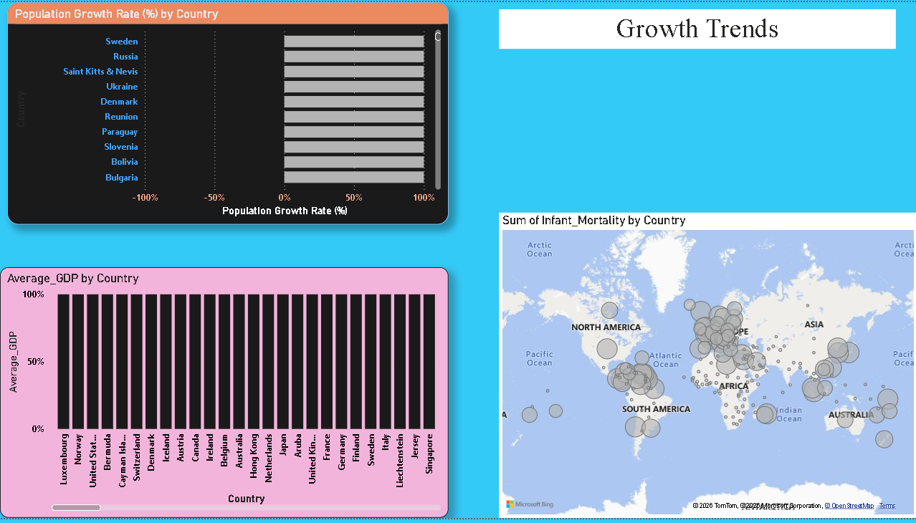
Growth Trends
Some regions show negative population growth
Higher literacy correlates with higher GDP per capita
Education and healthcare influence long-term growth

Slide 8
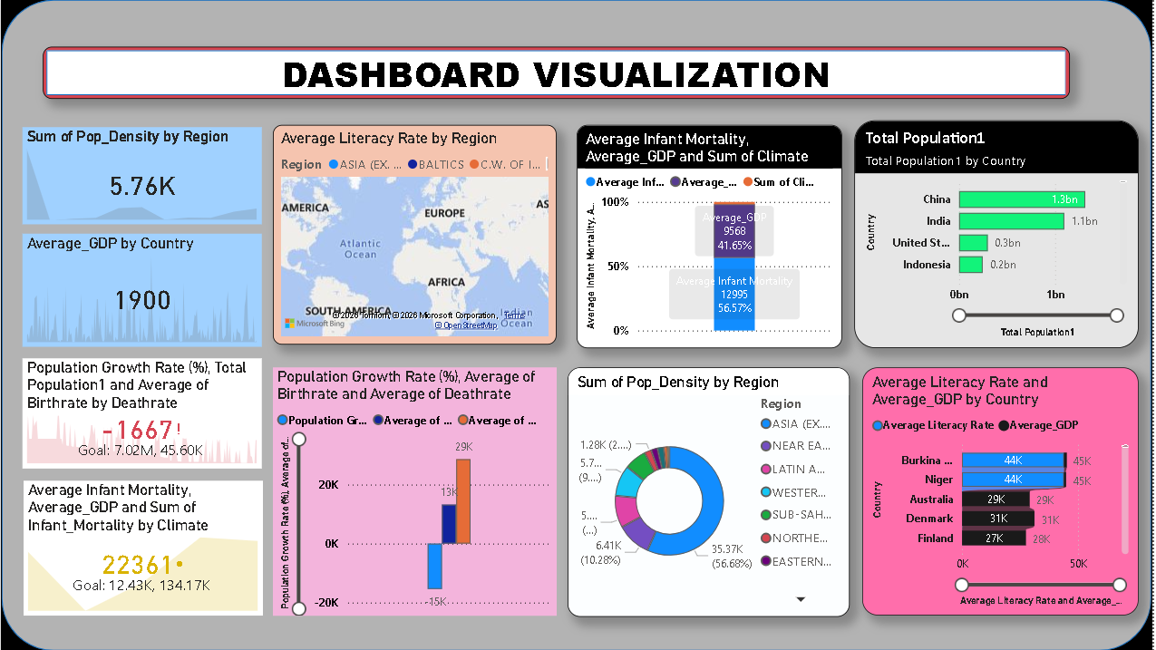
Dashboard Visualization

Slide 9
INSIGHTS :
Asia has the highest population, while Oceania and Baltics have the lowest.
Western Europe and Northern America show the highest average GDP despite smaller populations.
High population does not always mean high GDP, showing economic imbalance across regions.
Infant mortality is highest in low-GDP countries, indicating healthcare inequality.
Developed regions have very low infant mortality rates.
Literacy rates are highest in Europe and lowest in Sub-Saharan Africa.
Higher literacy is linked to higher GDP per capita.
Some developed regions show negative population growth, while developing regions continue to grow.
Countries with better education and healthcare perform better economically.
The dashboard clearly shows regional disparities in population, economy, and social indicators.

Slide 10
RECOMMENDATION :
Improve education in low-literacy regions to support economic growth.
Strengthen healthcare systems to reduce infant mortality rates.
Create job opportunities in high-population regions to manage population pressure.
Invest in infrastructure and industries in low-GDP regions.
Use data dashboards regularly for better policy and planning decisions.
Support skill development programs to increase productivity.
Monitor population growth trends to plan future resources effectively.

Slide 11
Thankyou

